Slide 1

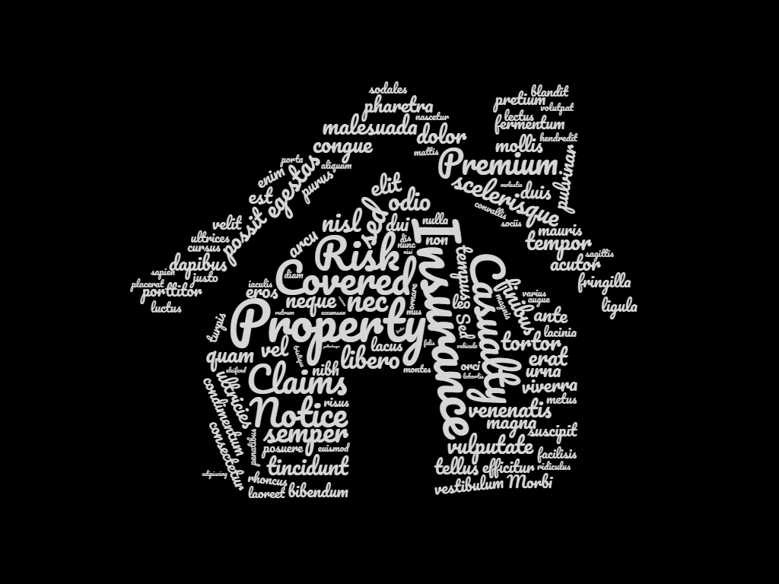
Property & Casualty Insurance
DXC.Technologies
By Rishi Pandya

Slide 2

Definition
Property and Casualty Insurance are types of coverage that help protect the stuff you own and also provide liability coverage to help protect you if you're found legally responsible for an accident that causes injuries to another person or damage to another person's belongings.

Slide 3






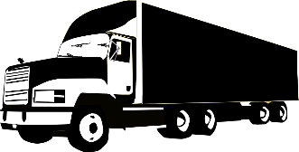

Property Coverages Covers
House
Commercial Buildings
Personal Belongings
Commercial Stuff
Jewelry
Money & Security
Personal Vehicles
Commercial vehicles

Slide 4
Liability Coverages Covers
Liability Coverages covers company's legal responsibility for the harm or loss it may cause to others.
Example:
Let’s say John owns a business of shifting goods.
One day Nick came to john and say, Hey! I want my goods to be shifted to my new home in xyz location.
John shifted the goods but due to his staff negligence and rash driving Nick’s new brand TV got damaged while during shifting.
Now Nick sues John for this negligence and his property damage.
Thanks to the General Liability coverages John took in his Business Insurance Policy that covers the claims done by Nick for his new TV.

Slide 5


OUR PREMIUM OFFERINGS
Gourmet Bagged Coffee
Deluxe Coffee Drinks
Delicious Local Food

Slide 6

OUR PREMIUM OFFERINGS
Gourmet Bagged Coffee
Deluxe Coffee Drinks
Delicious Local Food

Slide 7
REVENUE MODEL
Bagged Coffee
Coffee Beverages
Local Food
35 to 40 different varieties
Differing flavors, brew strengths, and different regions
Specialized coffee inventories
Priced by the pound
Ranging $4.00 to $40.00 per pound
Average $15.00 per pound. Customers choose coffee ground or not onside
Variety of coffee beverages
Three different size cups
Priced from $2.50 for a 12-ounce drip coffee to $5.75 for a 20-ounce latte
Provides a steady and reliable source of income
Highly predictable and high margin
Direct sale of food products
Locally sourced
Reputable and recognizable vendor and/or chefs.
May include sandwiches, bagels, burritos, pastries, and cookies

Slide 8
SALES FORECAST
3 YEAR SALES SUMMARY | YR1 | YR2 | YR3
TOTAL SALES | $702,000 | $772,200 | $849,420
TOTAL COGS | $212,000 | $222,600 | $233,730
NET PROFIT | $490,000 | $549,600 | $615,690
ANNUAL SALES & GROSS PROFIT

Slide 9
KEY TIMELINE GOALS
2/1/18
5/12/18
8/20/18
11/28/18
Business / Marketing Plan
Secure Funding
Build Out
Grand Opening
Achieve 700+ Daily Customers

Slide 10



THE TEAM
MANAGER
OWNER
KEY EMPLOYEE
First Last
First Last
First Last

Slide 11
BUSINESS RATIOS
FINANCIAL RATIOS | YR1 | YR2 | YR3
PROFIT MARGIN | 12.07% | 14.95% | 17.66%
ASSETS TO LIABILITIES | 2.83 | 4.24 | 7.44
EQUITY TO LIABILITIES | 1.83 | 3.24 | 6.44
ASSETS TO EQUITY | 1.55 | 1.31 | 1.16
LIQUIDITY RATIOS | YR1 | YR2 | YR3
ACID TEST | 2.34 | 3.66 | 6.67
CASH TO ASSETS | 0.83 | 0.86 | 0.90
SUCCESS RATIOS

Slide 12
MAJOR COMPETITORS
Starbucks – 1 mile
Started the specialty coffee chain phenomena in America in 1982. 99% are company owned. Revenues exceeded $6 billion in 2002. Average store gross revenue is $805,000. Now in 30 countries. Same store sales increased by 10% in 2002.
Caribou Coffee – 2 miles
Second largest all company-owned chains. Founded in 1992 in Minneapolis.
Tully’s – 400 feet
The third largest company-owned chain. Another Seattle-born company. The only coffeehouse chain that has not experienced excellent growth every year; business.com cites poor management as the reason. New management seems to leading a turnaround.

Slide 13
REQUIRED FUNDING
OTHER INVESTMENT
DEBT INVESTOR
$55,000 – 21%
$100,000 – 39%
BANK
OWNER EQUITY
$50,000 – 20%
$50,000 – 20%

Slide 14
USE OF FUNDS
LEASE DEPOSIT 1%
INITIAL LEASE PAYMENTS 3%
FF&E 24%
MISCELLANEOUS COSTS 8%
IMPROVEMENTS 20%
WEBSITE DEVELOPMENT 2%
FIXED STARTUP EXPENSES
RETAIL BUSINESS INSURANCE 2%
WORKING CAPITAL 28%
MARKETING 4%
COFFEE SUPLIES INVENTORY 8%

Slide 15

THANK YOU!
CONTACT US AT:
First Last
First.Last@email.com
123 123 1234

